Slide 1

Neural networks –activation functions, optimizers and Multi-class classification

Slide 2

Artificial Neural networks

Slide 3
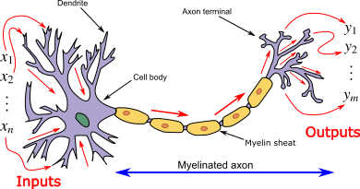
Artificial neural network motivation

Slide 4
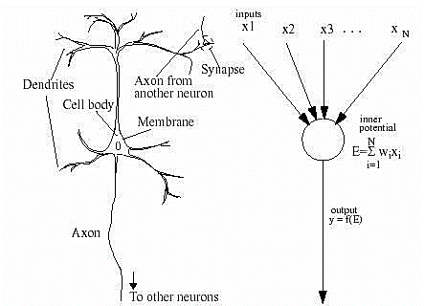
Structure of a neural network

Slide 5
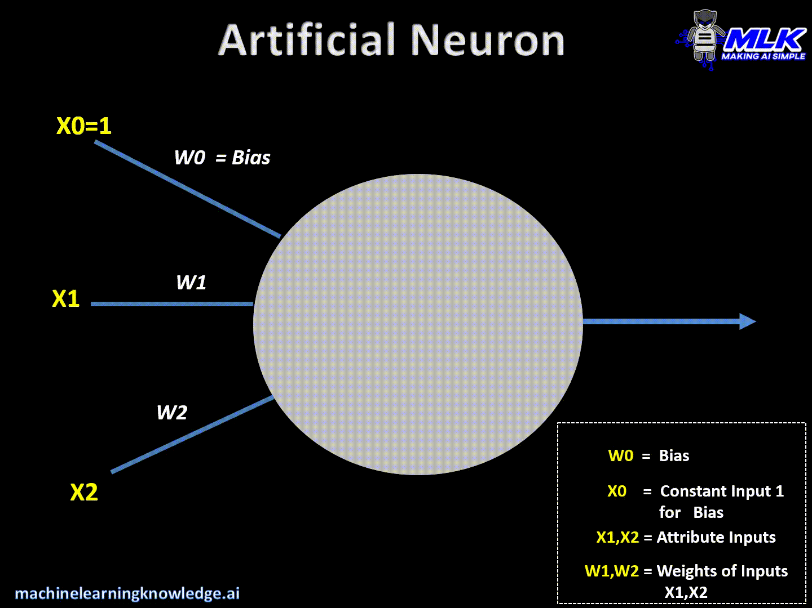

Slide 6
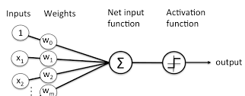
Single node neural network [Logistic regression]

Slide 7
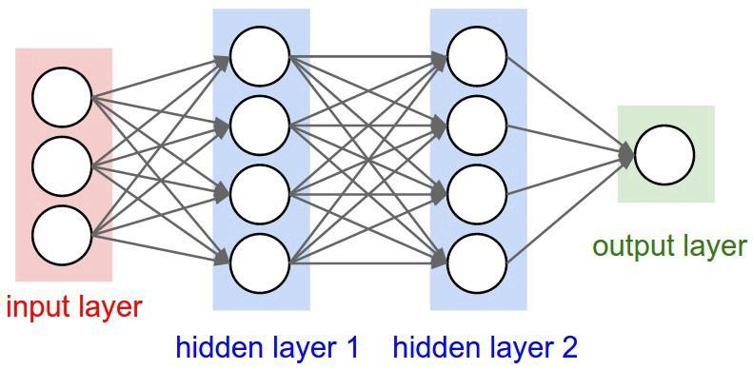
Layers in neural network

Slide 8
Activation functions

Slide 9
Why non-linearity in Activation function?
So why do we need Non-Linearities?
Non-linear functions are those which have degree more than one and they have a curvature when we plot a Non-Linear function.
Real world is made of non linear data- for example generic heights of students in class follows bell curve or normal distribution.
Neural networks need to learn about real world data.
Neural-Networks are considered Universal Function Approximators. It means that they can compute and learn any function at all.
Almost any process we can think of can be represented as a functional computation in Neural Networks.

Slide 10
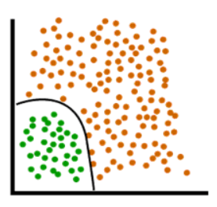
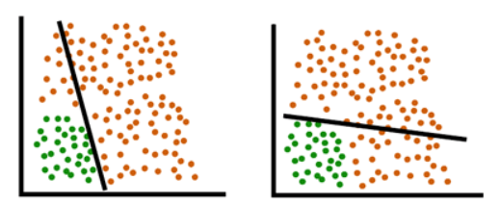

Slide 11
Activation functions
Why activation function?
If we do not apply a Activation function then the output signal would simply be a simple linear function.
A linear function is just a polynomial of one degree. Now, a linear equation is easy to solve but they are limited in their complexity and have less power to learn complex functional mappings from data.
A Neural Network without Activation function would simply be a Linear regression Model, which has limited power and does not performs good most of the times.
We want our Neural Network to not just learn and compute a linear function but something more complicated than that.
Also without activation function our Neural network would not be able to learn and model other complicated kinds of data such as images, videos , audio , speech etc

Slide 12

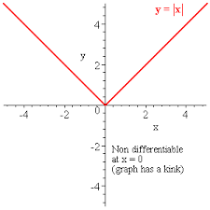
Important properties of Activation functions
Differentiable
Add non linearity to the model

Slide 13
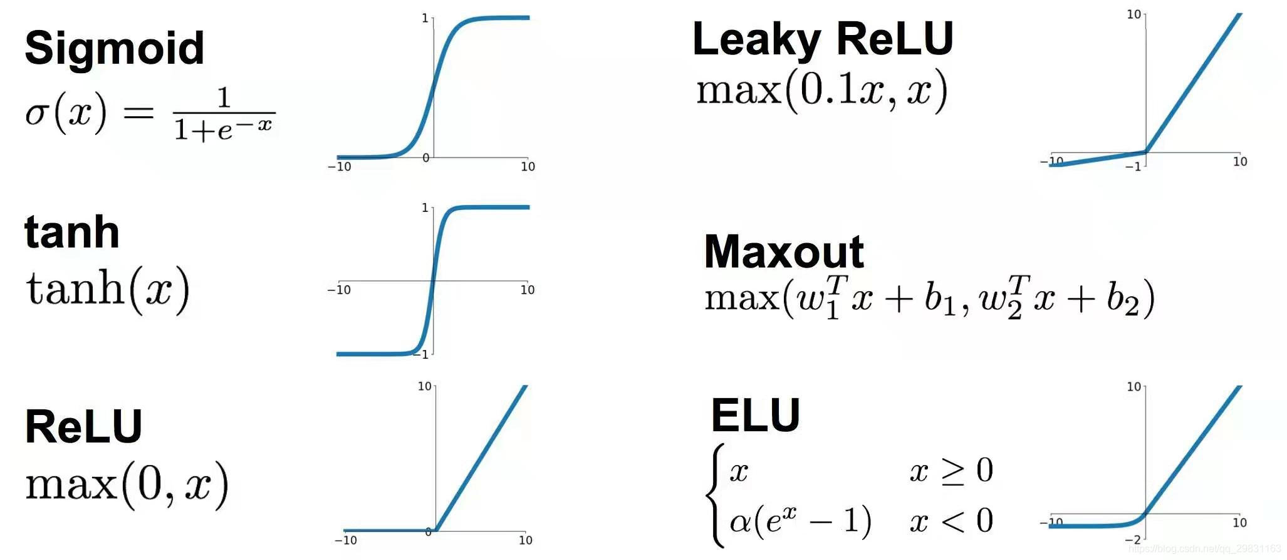
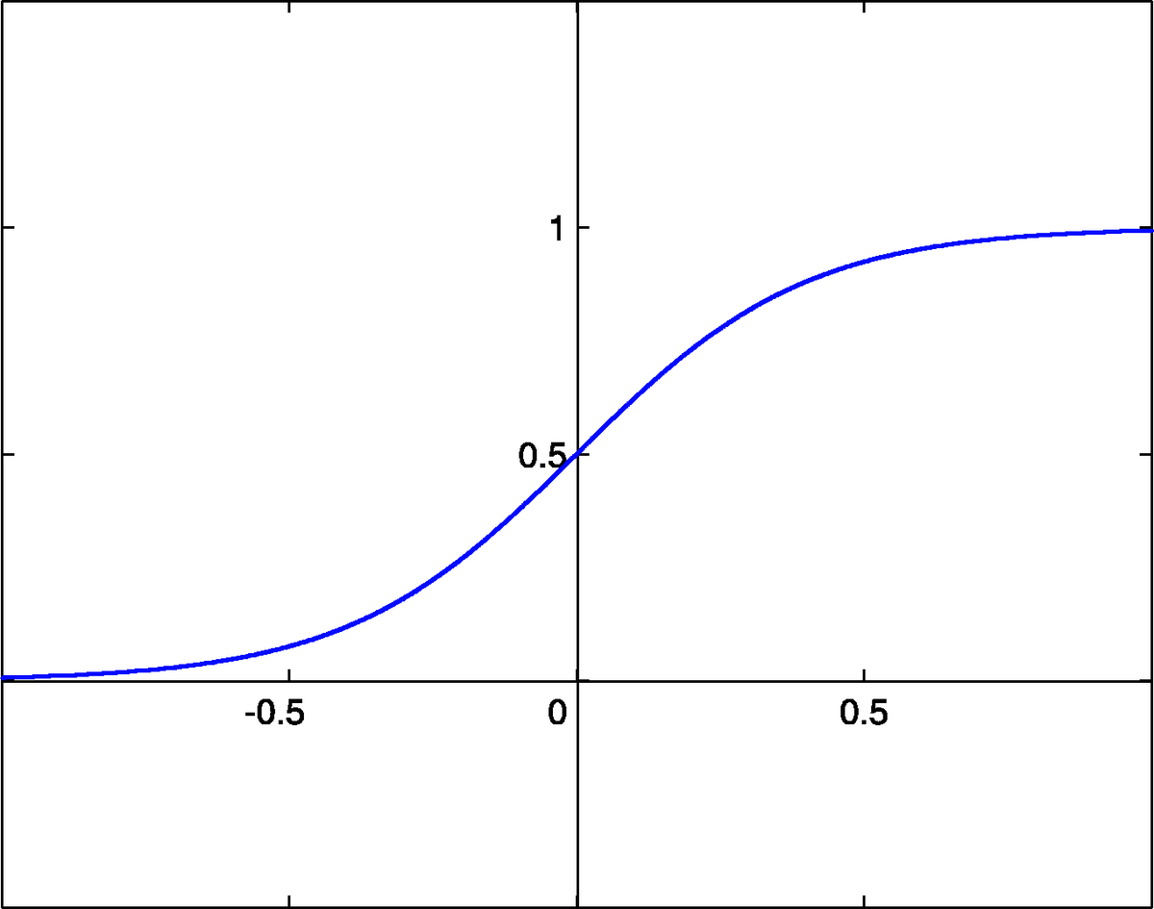
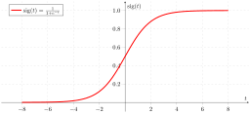
Important activation functions
Sigmoid or logistic
Tanh
ReLu
This Photo by Unknown Author is licensed under CC BY-SA
This Photo by Unknown Author is licensed under CC BY-SA
This Photo by Unknown Author is licensed under CC BY-SA

Slide 14

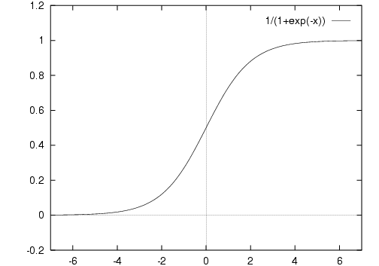
Sigmoid activation
It is a activation function of form f(x) = 1 / 1 + exp(-x) . Its Range is between 0 and 1. It is a S — shaped curve. It is easy to understand and apply but it has major reasons which have made it fall out of popularity -
Vanishing gradient problem
Secondly , its output isn’t zero centered. It makes the gradient updates go too far in different directions. 0 < output < 1, and it makes optimization harder.
Sigmoids saturate and kill gradients.
Sigmoids have slow convergence.

Slide 15
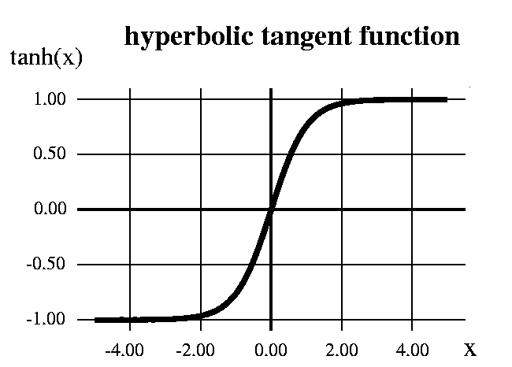
Tanh function
It’s mathamatical formula is f(x) = 1 — exp(-2x) / 1 + exp(-2x). Now it’s output is zero centered because its range in between -1 to 1 i.e -1 < output < 1 . Hence optimization is easier in this method hence in practice it is always preferred over Sigmoid function . But still it suffers from Vanishing gradient problem.

Slide 16
ReLu
It was recently proved that it had 6 times improvement in convergence from Tanh function. It’s just R(x) = max(0,x) i.e if x < 0 , R(x) = 0 and if x >= 0 , R(x) = x. Hence as seeing the mathamatical form of this function we can see that it is very simple and efficinent .
A lot of times in Machine learning and computer science we notice that most simple and consistent techniques and methods are only preferred and are best.
Hence it avoids and rectifies vanishing gradient problem . Almost all deep learning Models use ReLu nowadays
But it can be used only with hidden layers of neural network

Slide 17
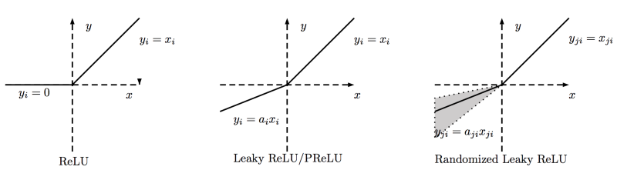
ReLu
Another problem with ReLu is that some gradients can be fragile during training and can die. It can cause a weight update which will makes it never activate on any data point again. Simply saying that ReLu could result in Dead Neurons.

Slide 18
Optimizations

Slide 19




Optimization functions
Optimization functions are used to minimize or maximise the error functions.
There are two types of optimization functions
First order optimization algorithms
Second order optimization algorithms

Slide 20
Different types of optimization functions
Gradient descent
Stochastic [revisited]
Mini batch
Adagrad
Ada delta
Adam

Slide 21
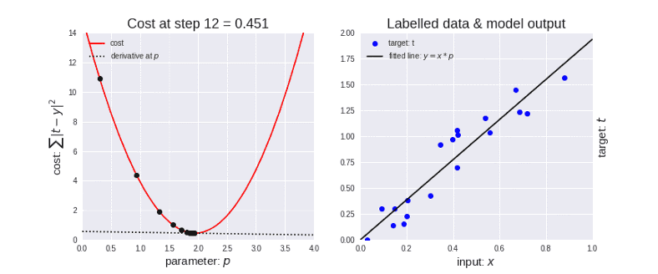
Gradient descent
θ=θ−η⋅∇J(θ) — is the formula of the parameter updates, where ‘η’ is the learning rate ,’∇J(θ)’ is the Gradient of Loss function-J(θ) w.r.t parameters-‘θ’.

Slide 22
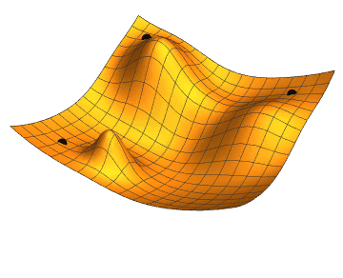
Intuitive understanding of gradient descent

Slide 23

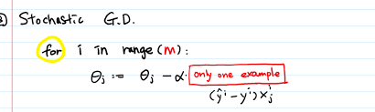



Stochastic gradient descent

Slide 24
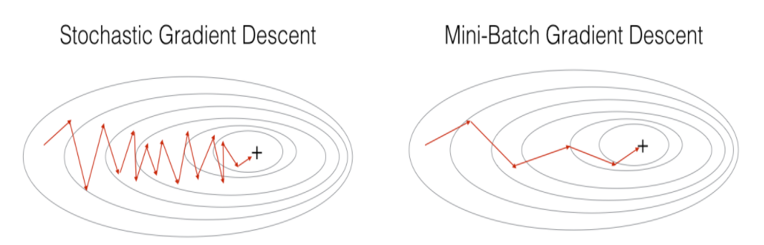
Stochastic vs mini_batch gradient descent

Slide 25
Stochastic gradient descent
Stochastic Gradient Descent(SGD) on the other hand performs a parameter update for each training example .It is usually much faster technique.It performs one update at a time.
θ=θ−η⋅∇J(θ;x(i);y(i)) , where {x(i) ,y(i)} are the training examples.
Now due to these frequent updates ,parameters updates have high varianceand causes the Loss function to fluctuate to different intensities. This is actually a good thing because it helps us discover new and possibly better local minima , whereas Standard Gradient Descent will only converge to the minimum of the basin as mentioned above.
But the problem with SGD is that due to the frequent updates and fluctuations it ultimately complicates the convergence to the exact minimum and will keep overshooting due to the frequent fluctuations .

Slide 26
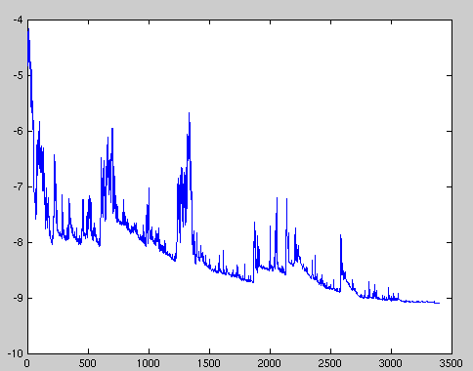
Stochastic gradient descent

Slide 27
Mini batch gradient descent
An improvement to avoid all the problems and demerits of SGD and standard Gradient Descent would be to use Mini Batch Gradient Descent as it takes the best of both techniques and performs an update for every batch with n training examples in each batch.
The advantages of using Mini Batch Gradient Descent are —
It Reduces the variance in the parameter updates , which can ultimately lead us to a much better and stable convergence.
Commonly Mini-batch sizes Range from 50 to 256, but can vary as per the application and problem being solved.
Mini-batch gradient descent is typically the algorithm of choice when training a neural network nowadays

Slide 28
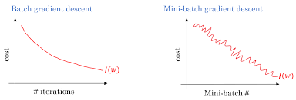
Gradient descent vs Mini-batch gradient descent

Slide 29
Challenges faced while using Gradient Descent and its variants —
Choosing a proper learning rate can be difficult. A learning rate that is too small leads to painfully slow convergence which directly affects the overall training time which gets too large.
Additionally, the same learning rate applies to all parameter updates. If our data is sparse and our features have very different frequencies, we might not want to update all of them to the same extent, but perform a larger update for rarely occurring features.
Another key challenge of minimizing highly non-convex error functions common for neural networks is avoiding getting trapped in their numerous sub-optimal local minima. Actually, Difficulty arises in fact not from local minima but from saddle points, i.e. points where one dimension slopes up and another slopes down.

Slide 30
Ada grad
Previously, we performed an update for all parameters θ at once as every parameter θ(i) used the same learning rate η. As Adagrad uses a different learning rate for every parameter θ(i) at every time step t, we first show Adagrad’s per-parameter update, which we then vectorize. For brevity, we set g(t,i) to be the gradient of the loss function w.r.t. to the parameter θ(i)at time step t .
Adagrad modifies the general learning rate η at each time step t for every parameter θ(i) based on the past gradients that have been computed for θ(i).
The main benefit of Adagrad is that we don’t need to manually tune the learning Rate. Most implementations use a default value of 0.01 and leave it at that.

Slide 31
Adam
Adam works well in practice and compares favorably to other adaptive learning-method algorithms as it converges very fast and the learning speed of the Model is quiet Fast and efficient and also it rectifies every problem that is faced in other optimization techniques such as vanishing Learning rate , slow convergence or High variance in the parameter updates which leads to fluctuating Loss function

Slide 32
Adam stands for Adaptive Moment Estimation. Adaptive Moment Estimation (Adam) is another method that computes adaptive learning rates for each parameter. In addition to storing an exponentially decaying average of past squared gradients like AdaDelta ,Adam also keeps an exponentially decaying average of past gradients M(t), similar to momentum:

Slide 33
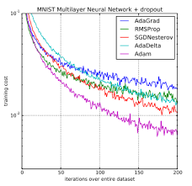
Different optimizers performance on Mnist multi layer neural network

Slide 34
Multi-class classification using ANN

Slide 35

Multi class classification

Slide 36
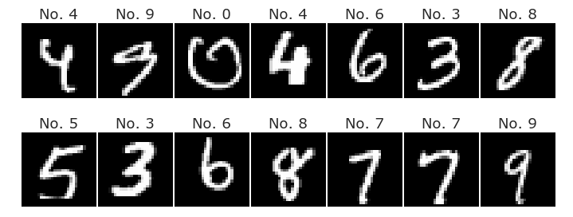
MNIST Data set
The MNIST dataset is an image dataset of handwritten digits.
It has has 60,000 training images and 10,000 test images, each of which are grayscale 28 x 28 sized images.
It is a good beginner’s dataset to try learning techniques and pattern recognition methods on real-world data while spending minimal efforts on pre-processing and formatting.

Slide 37
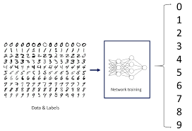
MNIST Multi-class classification

Slide 38
Slide Downloadable Link
https://drive.google.com/file/d/1D7vxZXJ0xBiYTTd8z4IvEbO9us5lxzMm/view?usp=sharing

